Slide 1
Machine Learning for Computer Systems
Nick Feamster University of Chicago

Slide 2
Resource Allocation

Slide 3
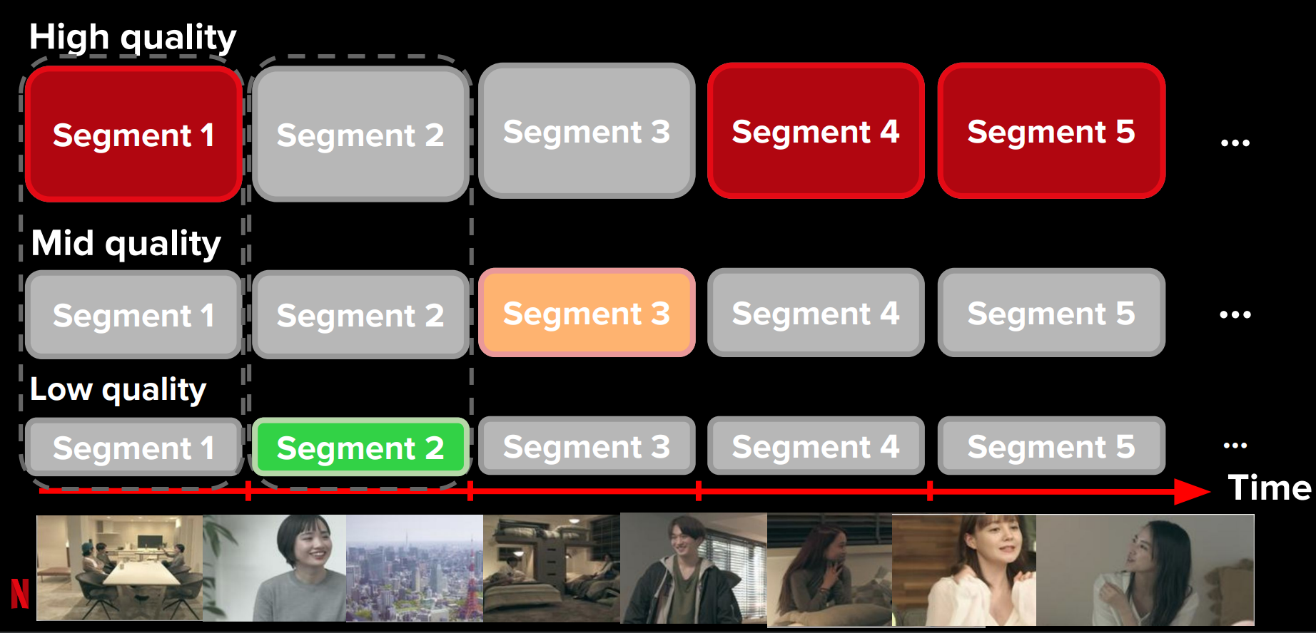
Goal: Adapt Video Quality Based on Changing Conditions

Slide 4
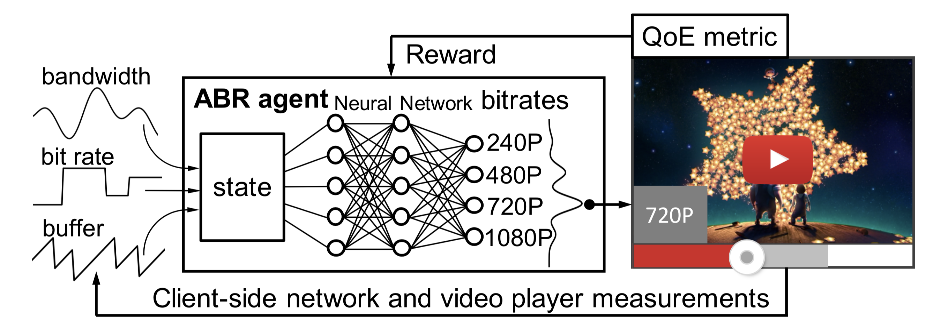
Pensieve: Video bit-rate adaptation
[Neural adaptive video streaming with Pensieve
Hongzi Mao et al, SIGCOMM’17]

Slide 5
Example #1: Video Bit-rate Adaptation
Features:
Past segment throughput
Past segment download time
Next segment sizes (at varying bitrates)
Current buffer size
Number of segments left
Last segment bitrate
Target: map state to requested bit-rate

Slide 6
Example #2: Congestion Control
Features:
Interarrival time between ACKs (EWMA)
Time between TCP sender timestamps (EWMA)
Ratio between most recent RTT and minimum RTT
Target:
A multiple to the current congestion window
Increment or decrement to the congestion window
A lower bound on time between successive packet transmissions

Slide 7
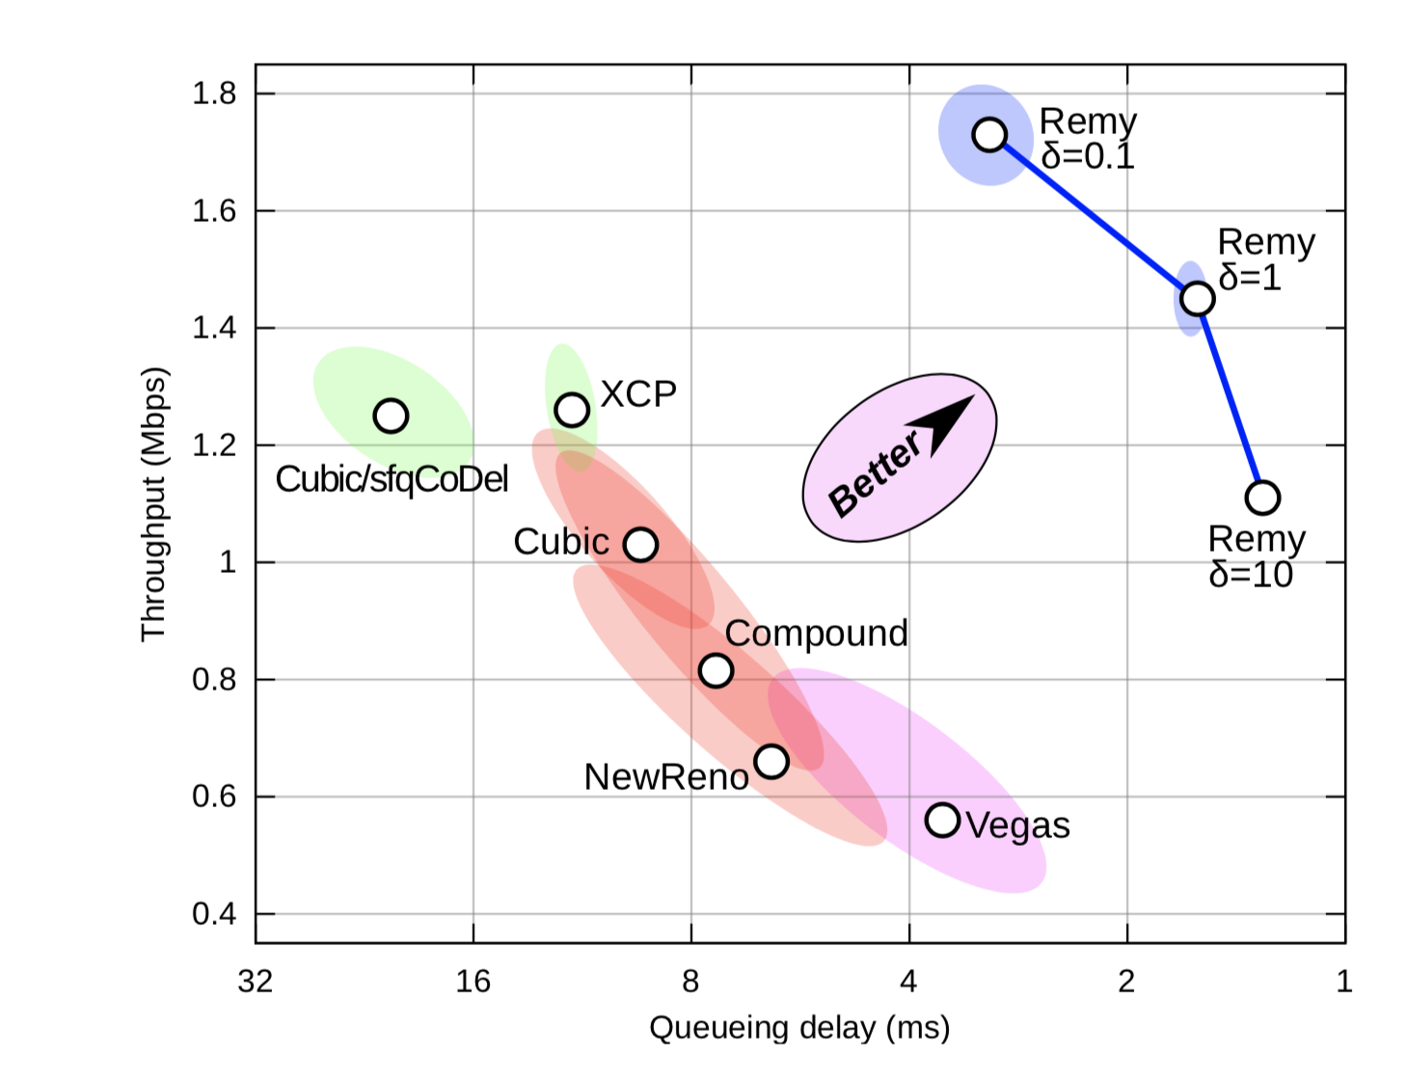
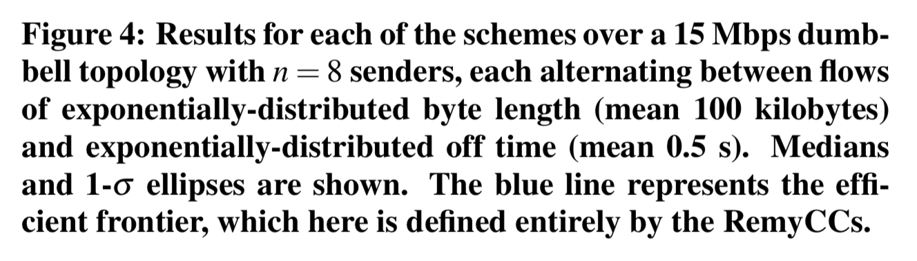
Remy: Congestion Control
[Computer-generated congestion control, Winstein and Balakrishnan, SIGCOMM’13]

Slide 8
Long(er)-Term Resource Allocation

Slide 9
WISE: “What If” Scenario Evaluator
What-if Scenario Evaluator for CDNs
Predicts distribution of response time for hypothetical network deployment and configuration questions
Uses causal structure among system variables and machine learning to answer the what-if questions
Tariq, Mukarram and Zeitoun, Amgad and Valancius, Vytautas and Feamster, Nick and Ammar, Mostafa. Answering what-if deployment and configuration questions with WISE. ACM SIGCOMM. August 2008.

Slide 10
Predicting Behavior: Observations
Typical what-if scenario is a modification to an existing, baseline setup
Implication: we have a good sense of “starting-point” from dataset of existing deployment
Response-time function is a black-box but there is a lot of data to learn about the system
Implication: use machine learning instead of analytical modeling

Slide 11
WISE: “What If” Scenario Evaluator
Distribution of input variables X under the “what-if” conditions
Service Response-time Estimation Function rt = f (X)
Distribution of response-time under the “what-if” conditions
What are the variables (X)?
What is this function?
Sufficient to determine the response-time (domain knowledge)
Statistically learned using the data from the existing deployment
What is the distribution under “what-if” conditions?
Existing deployment = Distribution of existing conditions
How to transform current scenario to “what-if”?
11

Slide 12
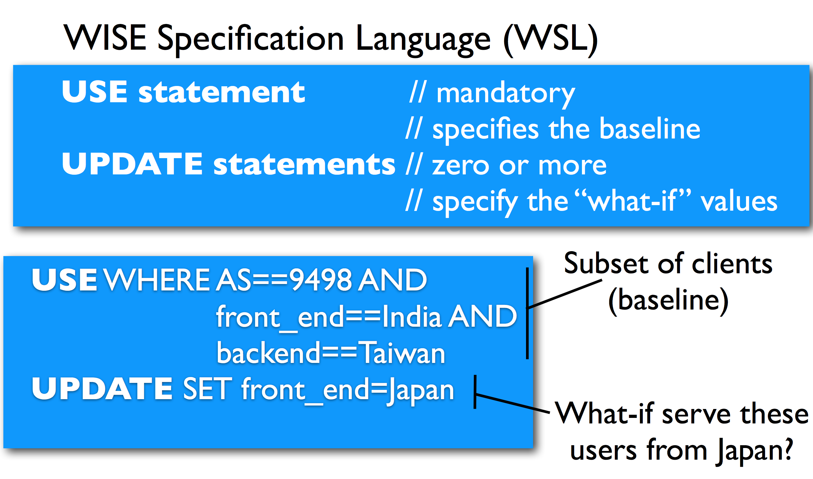
Scenario Specification

Slide 13
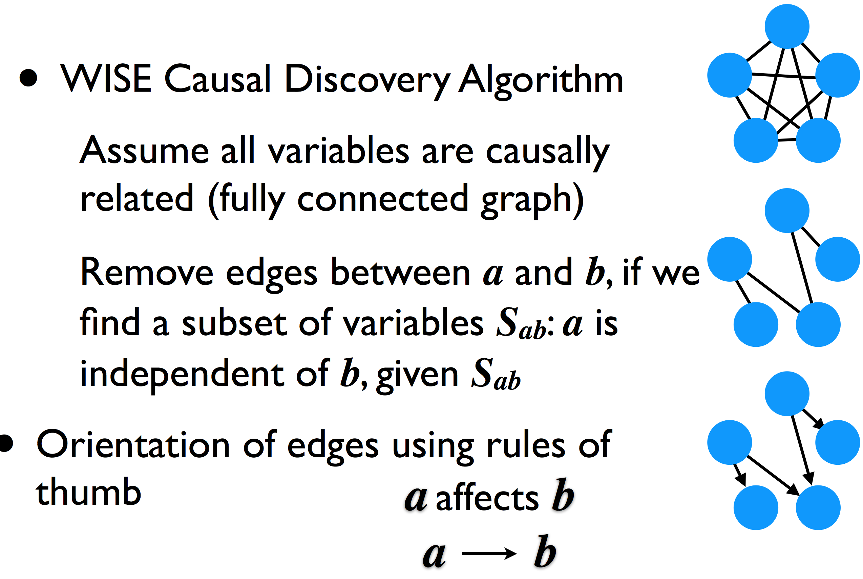
Learning Causal Structure

Slide 14
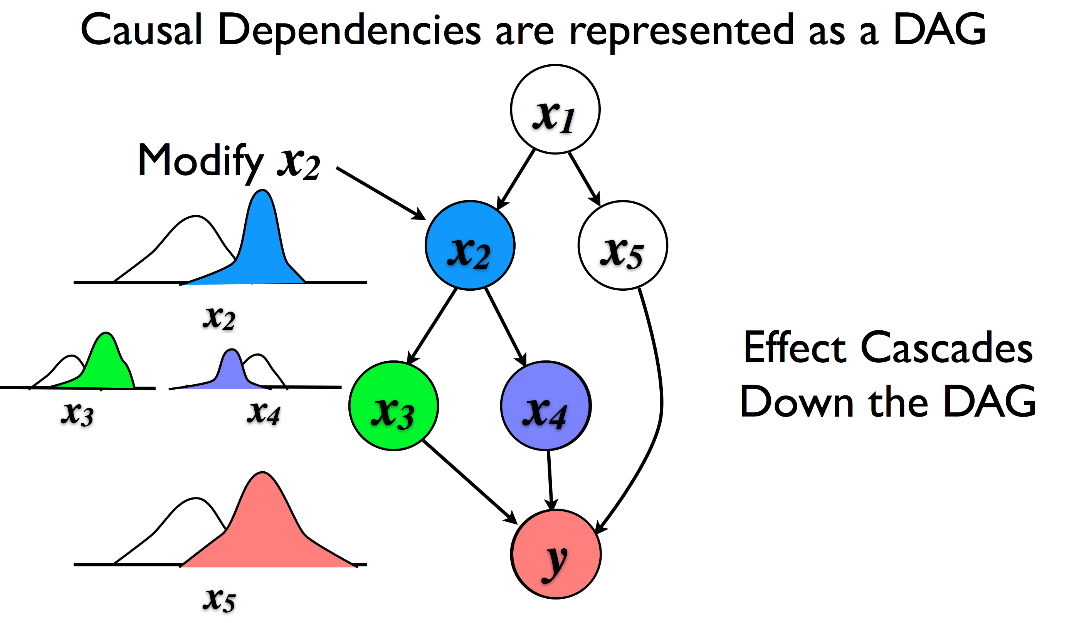
Guiding Transformation

Slide 15
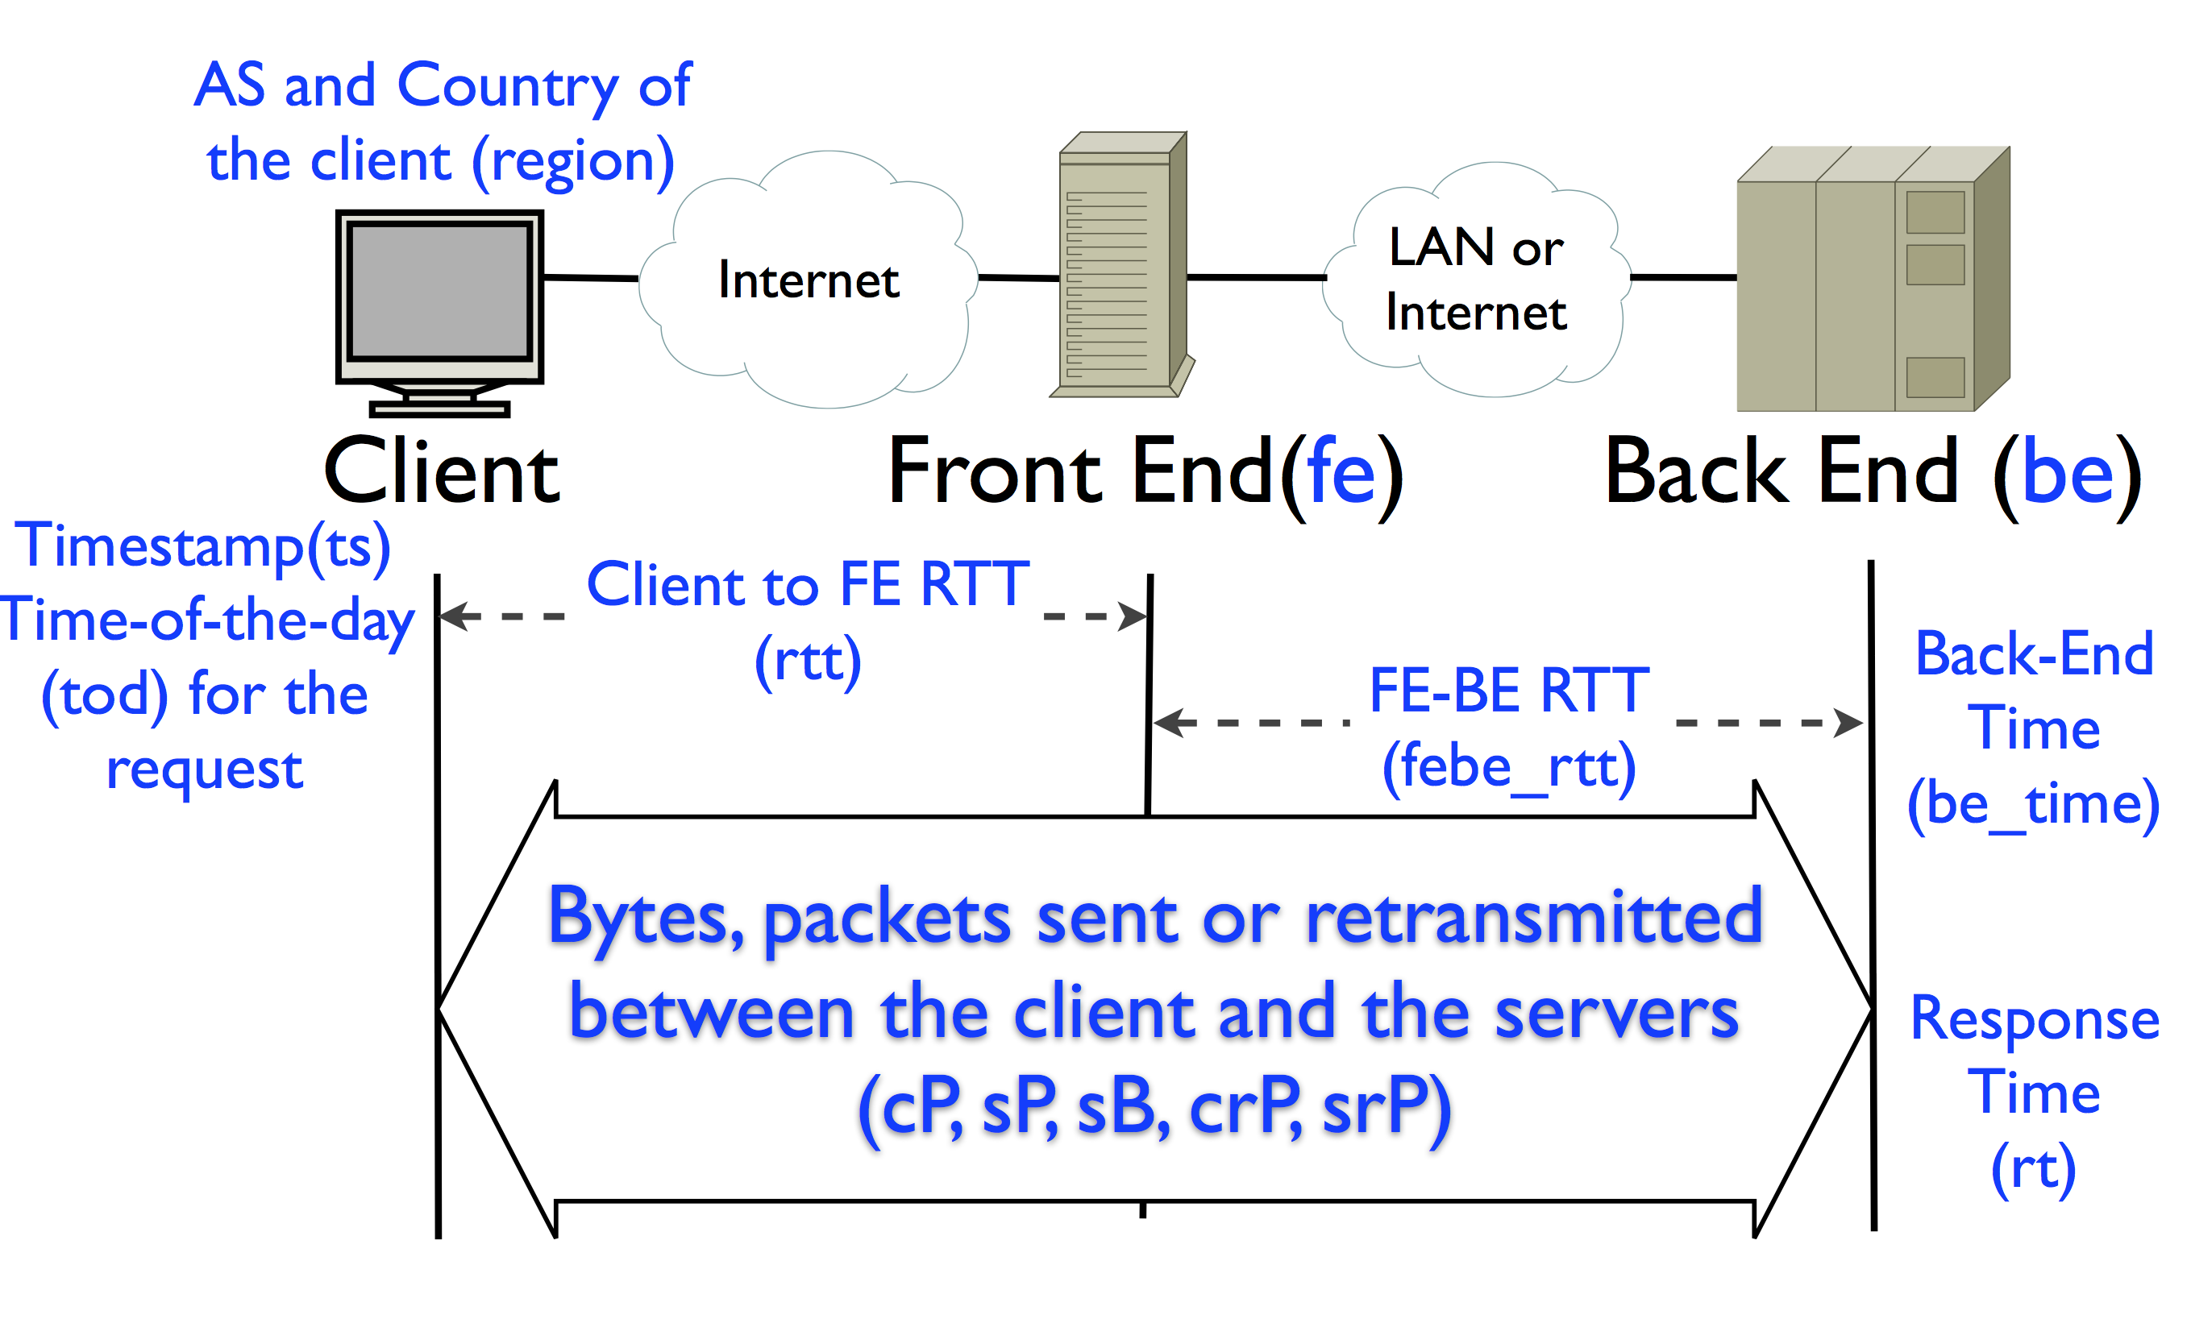
Google Web Service

Slide 16
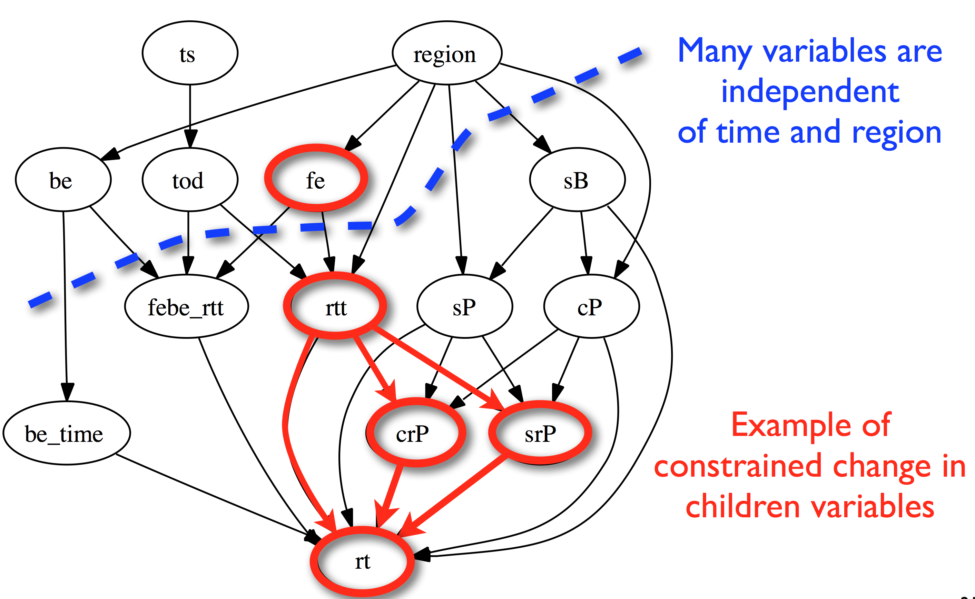
Propagating Changes

Slide 17
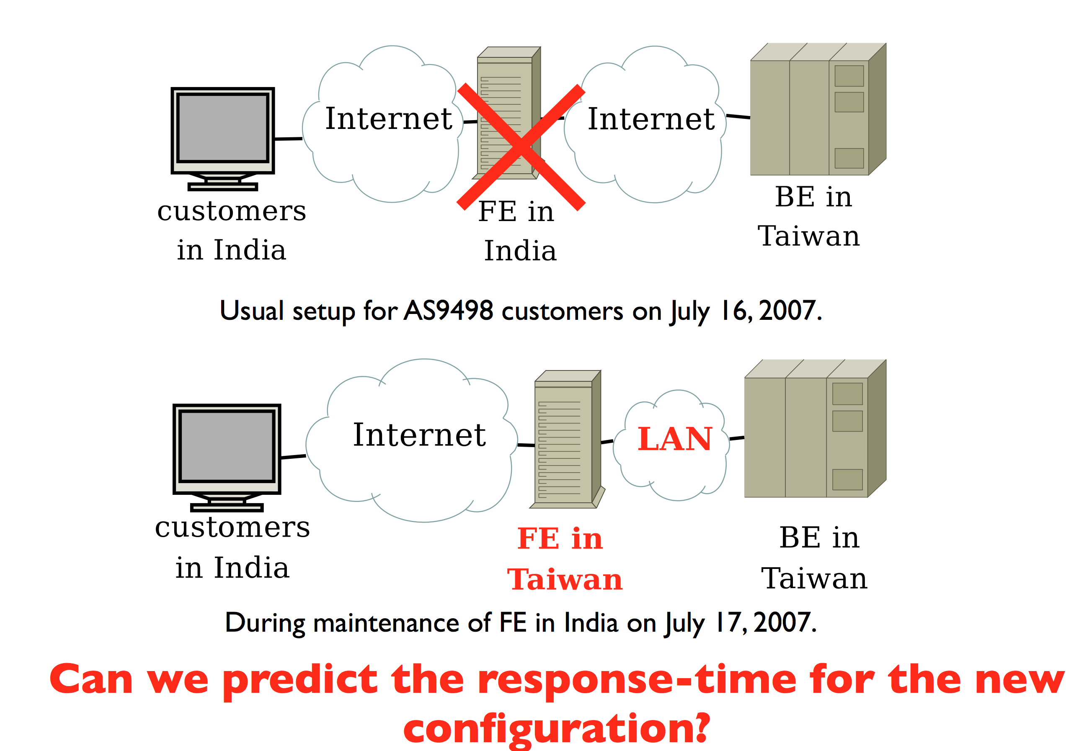
Example: “Draining” a Data Center

Slide 18
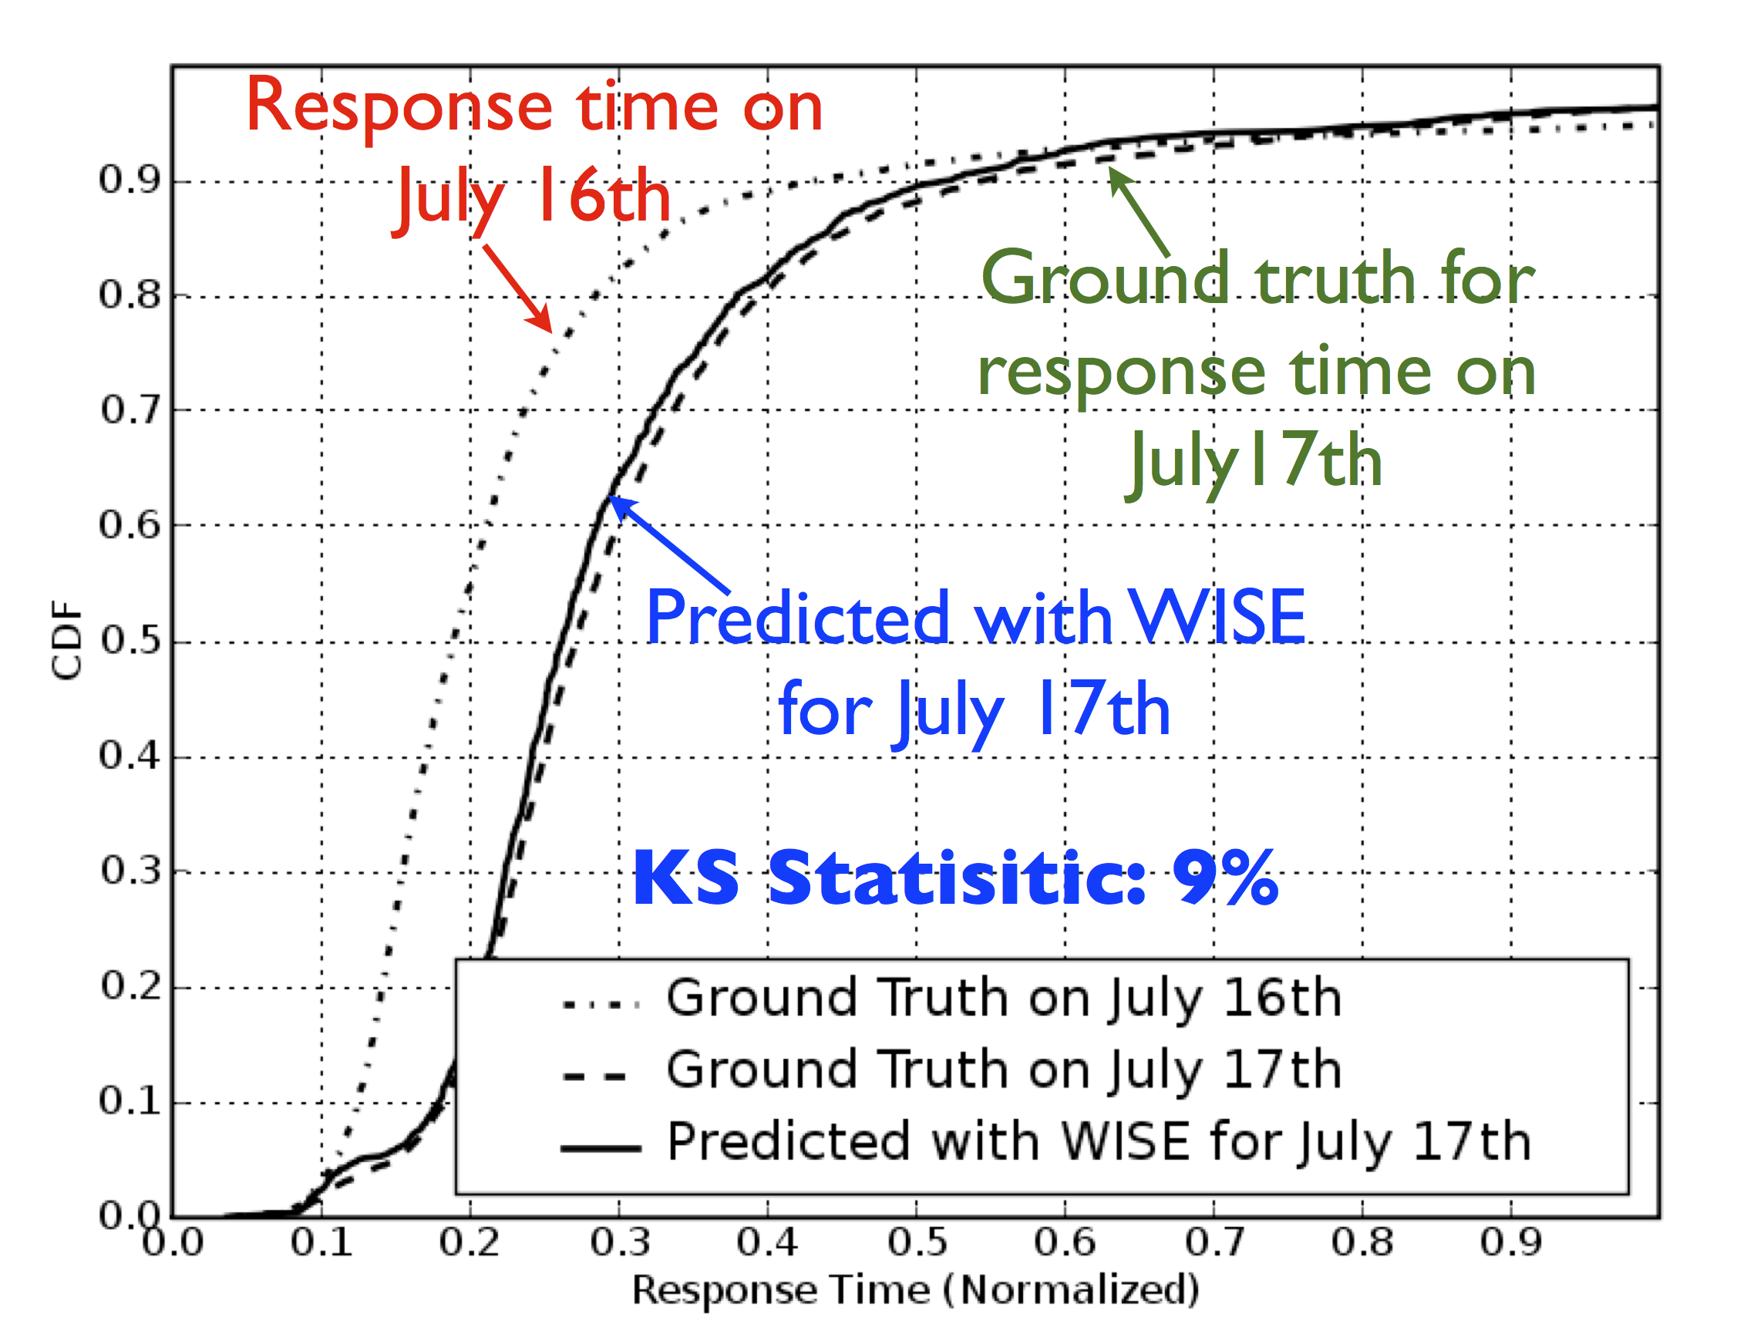
High Prediction Accuracy

Slide 19

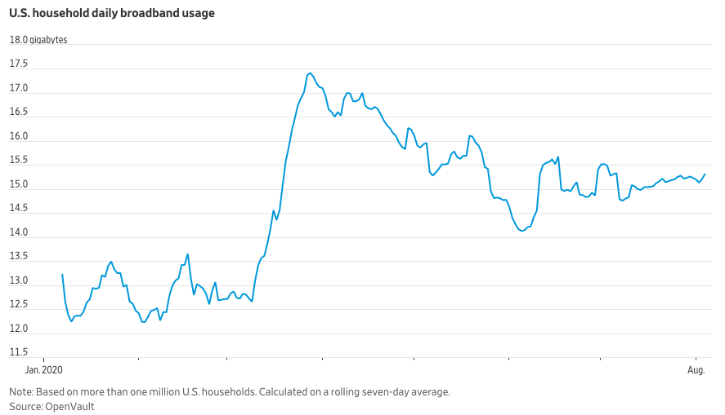
Case Study: The Internet Under Covid

Slide 20
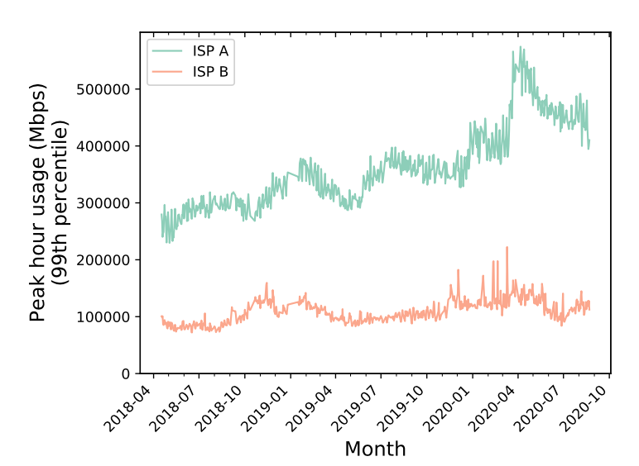
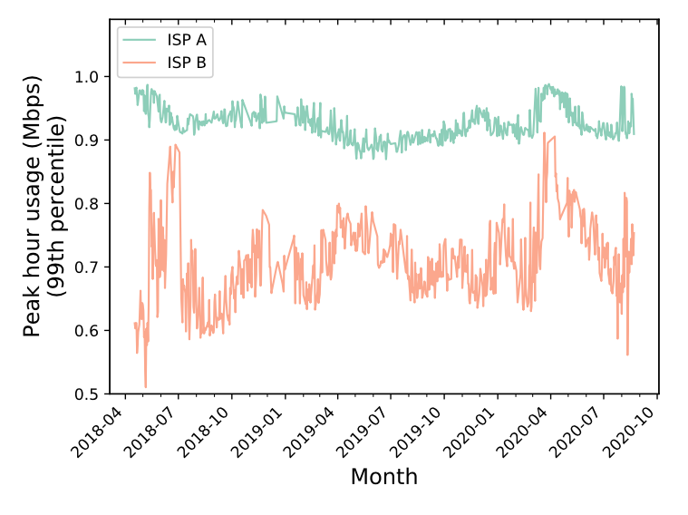
Traffic Volumes Increased

Slide 21
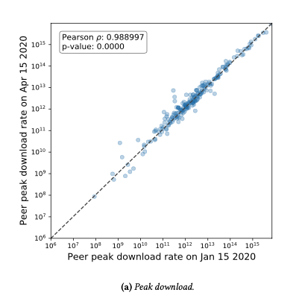
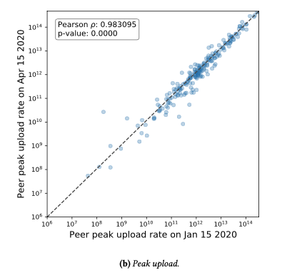
Traffic Ratios Changed

Slide 22
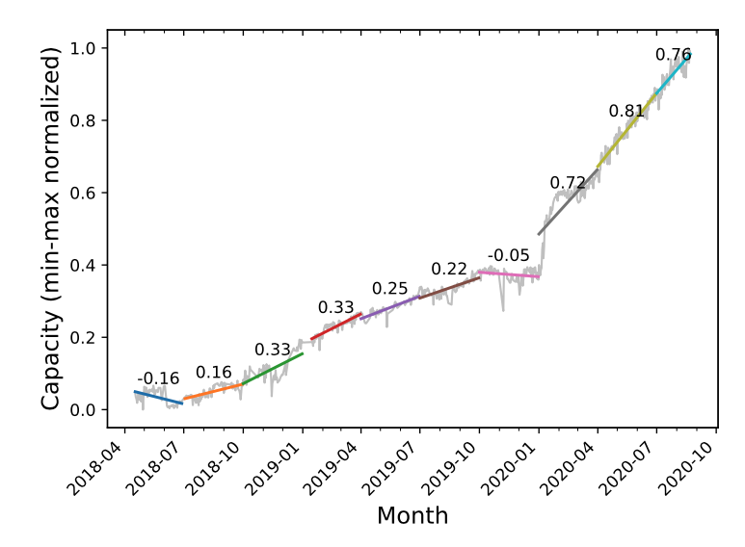
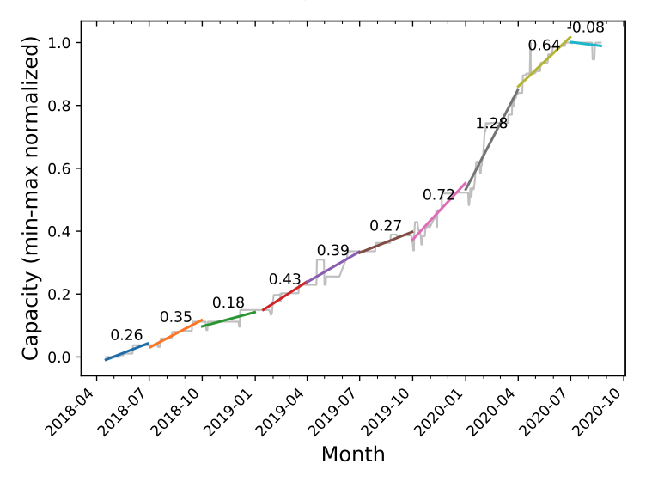
ISPs (Rapidly) Augmented Capacity

Slide 23
To be continued…
Many models for provisioning Internet capacity, diagnosing performance, etc. were disrupted by Covid (changes in patterns were “out of sample”).
Models must thus be able to adapt as conditions change, dealing with a phenomenon we sometimes refer to as “model drift”.

